Slide 1

The role of CpG oligonucleotides in Immuno-oncology: From Bench to Bedside to Pharma to Bedside
Arthur M. Krieg, MD

Slide 2
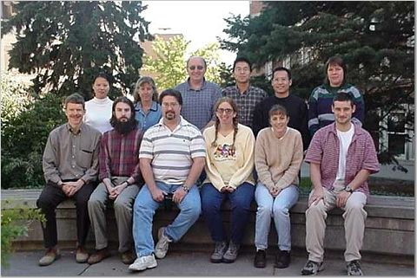
Krieg Lab (circa ~1999)

Slide 3
Colleagues and Collaborators
The CpG Group
Zuhair Ballas
John Cowdery
Joel Kline
Dave Lubaroff
Tim Ratliffe
Tom Waldschmidt
George Weiner
Gail Bishop
John Harty
Gary Koretzky
Steve Lentz
Mike Welsh
Bob Ashman
Frank Abboud

Slide 4
The Controls That Weren’t
1991: My lab was using antisense oligonucleotides to try to turn off genes that I thought may be important in regulating autoimmune B cells
Some of the control DNA activated the B cells VERY strongly
The antisense experiments weren’t working
Why did the control DNAs activate the B cells?
After making hundreds of DNAs where I tried changing each of the bases around, I realized the stimulation was from having a CG in certain contexts

Slide 5
Why would the immune system bother to be activated by CpG motifs?
Did this serve some purpose, or was it just a strange artifact?

Slide 6
How does the immune system detect infection?
Germs
Skin
Dendritic cells
Capillary

Slide 7

Pathogen-associated molecular patterns are detected by innate immune cells
Charles Janeway
Germs
Skin
Dendritic cells
Cytokines, chemokines - “alarms”
Capillary recruits immune cells

Slide 8
Immune cells detect unmethylated CpG DNA as a signal indicating infection:
“Danger Signal”
Bacterial DNA has the expected frequency of CpG (~1/16 bases): ACGTTGAGTTCGTACGCATACGA
Vertebrate DNA has few CpG (~1/100 bases) and they are methylated: AGCTTGAGTC^{m}CGGATGGGTAAGA
We showed that an innate immune defense recognizes this molecular pattern of foreign DNA (unmethylated CpG), which indicates infection
Vertebrate DNA does not activate
Bacterial DNA does (eliminated by CpG methylase)
Bacterial DNA can be mimicked with synthetic oligonucleotides:
CpG 7909: TCGTCGTTTTGTCGTTTTGTCGTT

Slide 9
Some TLRs Are on the Cell Surface, to Detect Extracellular Pathogens
Bacterial lipopeptides
GPI-anchored proteins (parasites)
Lipoteichoic acid (gram + bacteria)
zymosan (fungi)
LPS (gram - bacteria)
Flagellin (motile bacteria)
2
2
6
4
4
1
2
5
CELL MEMBRANE
7
8
3
9
dsRNA
(viruses)
ssRNA
(viruses)
CpG DNA
(bacterial and viral DNA)
ENDOSOME

Slide 10
Some TLRs Are Inside the Cell, to Detect Intracellular Pathogens
Bacterial lipopeptides
GPI-anchored proteins (parasites)
Lipoteichoic acid (gram + bacteria)
zymosan (fungi)
LPS (gram - bacteria)
Flagellin (motile bacteria)
2
2
6
4
4
1
2
5
7
8
In humans, TLR9 is expressed only in plasmacytoid dendritic cells (pDC) and B cells: pDC express only TLR7 and TLR9
3
9
dsRNA
(viruses)
ssRNA
(viruses)
CpG DNA
(bacterial and viral DNA)
ENDOSOME

Slide 11
TLR Expression is Cell-Specific - human
B cell pDC mDC mono
plasmacytoid DC myeloid DC
1,6,7,9,10
1, 7, 9
1,2,3,4,5,
6,8,10
1,2,4,5,6,8
PMN T cell NK eos
1,2,4,5,6,
8,10
1,5?
1,2,3,
5,6
7
Disclaimer – the literature on this subject is controversial on the details!!

Slide 12
TLR Expression is Cell-Specific - human
B cell pDC mDC mono
plasmacytoid DC myeloid DC
1,6,7,9,10
1, 7, 9
1,2,3,4,5,
6,8,10
1,2,4,5,6,8
pDC have a unique immune function:
When activated, produce >99% of the type I IFN made in response to infection
Immature pDC tolerize T cells rather than activate them, may have role in self tolerance
Are recruited by many tumors, induce Treg, protect against immune attack
PMN T cell NK eos
1,2,4,5,6,
8,10
1,5?
1,2,3,
5,6
7
Disclaimer – the literature on this subject is controversial on the details!!

Slide 13
TLR Expression is Cell-Specific - mouse
B cell pDC mDC mono
2,3,4,6,
7,9,10
1, 7, 9
1,2,3,4,5,
6,8,9,10
1,2,3,4,
5,6,9
PMN* T cell NK eos
1,2,3,4,6,
7,9,10
1,2,3,6
1?
7
Other rodents appear to have similar TLR distribution

Slide 14
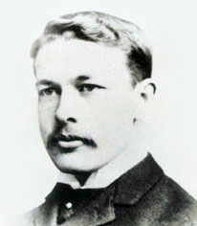
1st Decision Point
having discovered a new way to activate the immune system with CpG DNA, what do you do next?
File patent, write a paper (and grant!)
Start a company (thanks, Matt Howard, for telling me it’s only a teeny bit of work!)
Coley Pharmaceutical Group, after William B. Coley

Slide 15
2nd Decision Point
So we have a powerful new immune activator, what are we going to use it for?
Vaccine adjuvant
Allergy/asthma
Infectious disease (HCV, HBV, HIV)
Cancer

Slide 16
Status of non-oncology programs
Vaccine adjuvant
outstanding human data in multiple ID vaccines, CpG is the strongest human adjuvant
we partnered with several companies still in development – Dynavax is most advanced with Heplisav (completed phase 3)
Allergy/asthma
We partnered with Aventis
Positive human data but clinical hold from FDA – they merged with Sanofi and soon abandoned program; Astra-Zeneca is still developing inhaled CpG with Dynavax
Infectious disease (HCV, HBV, HIV)
We had positive phase 1/2 data in HCV but could not compete with oral direct anti-viral agents, abandoned program

Slide 17
3rd Decision Point
How to develop an innate immune activator in oncology in 2000?
In mouse models worked best by intratumoral injection: injection of one tumor induced regression of distant mets
Modest activity with systemic administration
Our original plan to develop CpG by intratumoral administration was abandoned after we talked to Pharma oncologists (but we still supported some small IT studies)
First, seek activity as monotherapy…

Slide 18
CPG7909 Efficacy As a Monotherapy
Metastatic melanoma (SC: 2/20 PR by RECIST)
Cutaneous T cell lymphoma (SC: 3 CR and 6 PR of 28 by CTCL assessment index)
Non-Hodgkin’s lymphoma (SC: by RECIST 2/23 late CR in relapsed pt; 1 progressed at 15 mos)
Renal cell carcinoma (SC: 2/35 PR by RECIST)
Basal cell carcinoma (IL: 1/5 CR and 3/5 PR)
Monotherapy activity not adequate to seek approval
Cancer vaccines (collaborations; partnered with GSK)
Combo with SOC chemo in NSCLC and melanoma

Slide 19
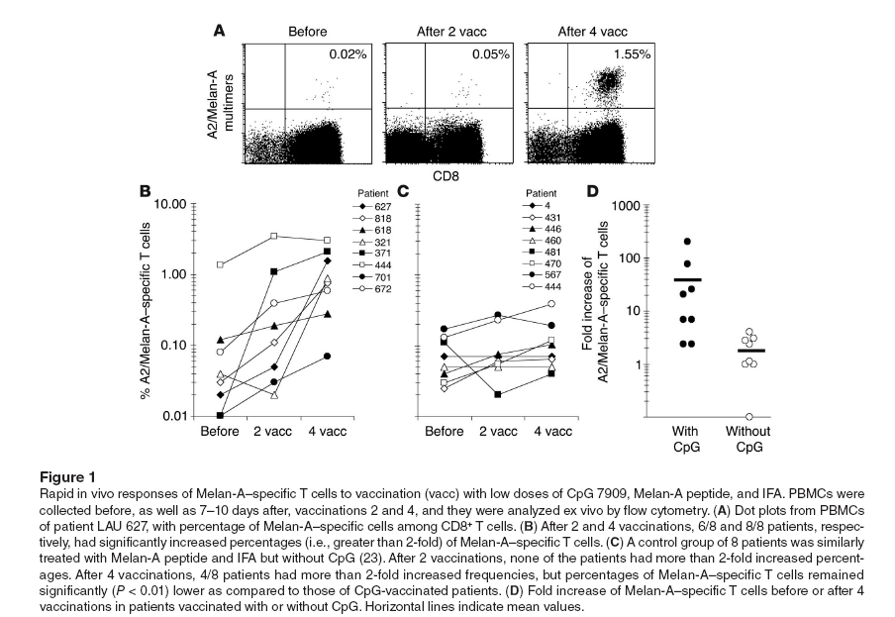
CpG 7909 As Tumor Vaccine Adjuvant Enhances CTL Response In Melanoma Patients
~10X Increase in Tumor-Specific CD8⁺ Killer T Cells in Melanoma Patients
Speiser et al., J Clin Invest, 2005

Slide 20

CPG 7909 Responses in Advanced Melanoma (Phase I/II)
Large melanoma tumors can regress with repeated vaccinations
Stage IV melanoma patients (N=6)
Multiple vaccinations at tri-weekly intervals
1 CR, 1 PR, 2 SD, 2 PD (based on RECIST criteria)
MAGE-3 protein + 1.0 mg CPG 7909
Patient 1
Sum of Tumor Diameter (cm²)
Patient 2
Dr. H.H. van Ojik, Erasmus, Rotterdam

Slide 22
All GSK phase 3 cancer vaccine trials have failed to meet all efficacy endpoints so far
Cancer vaccine field may be moving away from unmutated self antigens in favor of tumor-specific neoantigens

Slide 23
Can TLR9 stimulation by CpG enhance chemotherapy?
Theory:
Chemotherapy can enhance immunity:
Disrupts tumor stroma
Suppress regulatory T cells, increased anti-tumor CTL
CpG activates pDC in vivo
pDC induce T cell response that rejects tumor
Demonstrated in tumor-bearing mice: chemo + CpG induced anti-tumor T cells, prolonged survival
Will it work in humans?
Decision: do randomized controlled trials in melanoma (+/- DTIC) and NSCLC (+/- Gem/Cis)

Slide 24
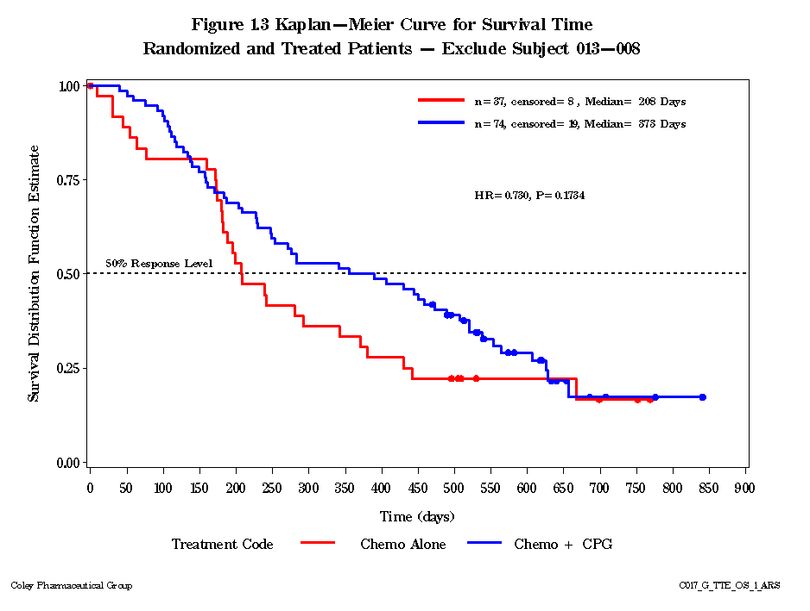
Phase 2 NSCLC: Trend to Improved Survival
Kaplan-Meier Curve for Survival Time
Randomized and Treated Patients
Chemotherapy alone
N = 37, censored = 8
Chemotherapy + PF3512676
N = 74, censored = 19
6.8 months
12.2 months
HR: 0.73
P: 0.173
Median Survival
Chemo alone 6.8 months
Chemo + PF3512676 12.2 months
% alive after 1 year
Chemo alone 33%
Chemo + PF3512676 50%

Slide 25
4th Decision point
Partner for phase III/commercialization with Pfizer
$515M license
$50M up-front
$10M equity at IPO
$455M future milestones
Tiered royalty rate
Pfizer responsible for all development and commercialization costs
Largest deal ever for a phase II cancer program
Pfizer launches two phase 3 trials in advanced NSCLC

Slide 26
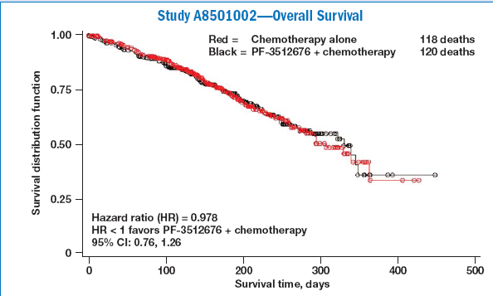
Both phase III trials failed (June 2007)!
Notes:
Until both Phase III trials were negative.

Slide 27
5th Decision Point and up to present
The Outcome: Sale Of Coley To Pfizer in 2008 for vaccine assets
Coley absorbed within Pfizer Vaccines (but not me)
I joined Pfizer as a CSO to form and lead a new RNA therapeutics group
18 mos later Pfizer decided to exit cancer immunotherapy
In 2011 Pfizer decided to exit RNA therapeutics, I decided to exit Pfizer
In 2011, investors were not interested in cancer immunotherapy, so I did other things for a while
In late 2014, after reviewing the state of the field of immuno-oncology, I decided to start a new company, Checkmate Pharmaceuticals
Sofinnova Ventures will lead a $20M Series A, have formed a team of ~10 very experienced Biotech execs to run a virtual company to develop a new CpG in combination with anti-PD-1/PD-L1

Slide 28














The Checkmate Team
Art Krieg | CEO
Bill Slichenmyer | CMO
Chuck Abdalian | CFO
Cindy Berman | VP Preclin. Safety
Norm Greenberg | SVP Transl. Med.
Frank Hennecke | EVP Drug Devt.
Ramani Varanasi | CBO
Chuck Yon | GC
Plus Office Manager, Program Manager
Advisors:
Bob Bratzler, Mike Powell

Slide 29







Checkmate Clinical Advisors
Charles Drake |  | Bladder, kidney cancer
David McDermott |  | Melanoma, kidney cancer
Ron Levy |  | NHL
Michael Lotze |  | Tumor immunity Surgical oncologist
Anthony Sandler |  | Pediatric surgical oncologist
Daniel Speiser |  | Melanoma, CpG-A and CpG-B vaccines
George Weiner |  | NHL, Cancer Center Director

Slide 30
Anti-PD-1/PD-L1 Clinical Efficacy is Exciting But “taking off the brakes” usually isn’t enough
Checkpoint inhibitors release suppression
Fail to point the immune system in the right direction
Rarely work in patients without TIL/PD-L1
Patterns seen in non-responders inform new directions
“immunological ignorance” - No or few TIL
“non-functional immune response” - TIL do not express PD-L1
“excluded infiltrate” - T cells only present outside tumor
Intratumoral injection of Checkmate CpG is expected to:
Induce CD8⁺ TIL
Drive strong Th1-like type I IFN response
Create an inflamed tumor microenvironment, induce strong Th1 anti-tumor response without the need to identify tumor-specific neoantigens

Slide 31
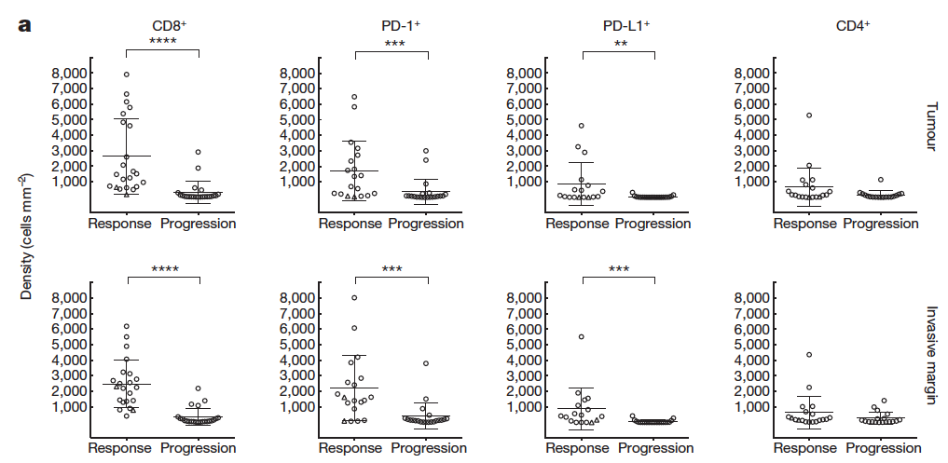
CD8⁺ TIL Predicts Response to Anti-PD-1; Correlates with PD-L1 Expression
But most tumors lack TIL, will have low response rates to anti-PD-1
Tumeh et al., Nature, 2014
CONFIDENTIAL

Slide 32
All CpG Induce PD-1 on Human CD4⁺, CD8⁺ T cells
CD4⁺
No change in CTLA-4 expression (not shown)
Data support clinical combination of CpG with anti-PD-1
Since CpG induces PD-1 expression, need to combine it with anti-PD-1 for clinical efficacy
CD8⁺
Human PBMC cultured for 48 hr and analyzed by FACS for T cell PD-1

Slide 33
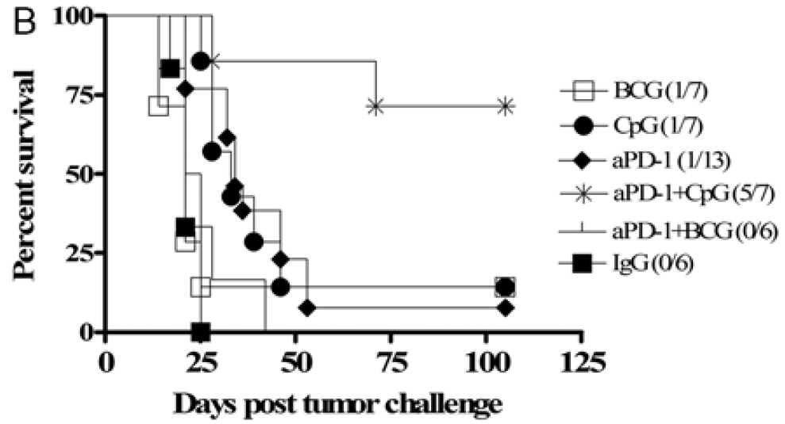
Anti-PD-1 + CpG Synergy Confirmed In Syngeneic Bladder Cancer Model
BCG
CpG
Anti-PD-1
Anti-PD-1 + CpG
Anti-PD-1 + BCG
IgG
Anti-PD-1 + CpG increased tumor-specific CD8 T cells and decreased tumor Treg
SC MB49 tumors (3 X 10⁵ cells), peritumoral CpG and IP Ab started on day 8; dosed q 3d
Mangsbo et al., J. Immunother. 2010

Slide 34
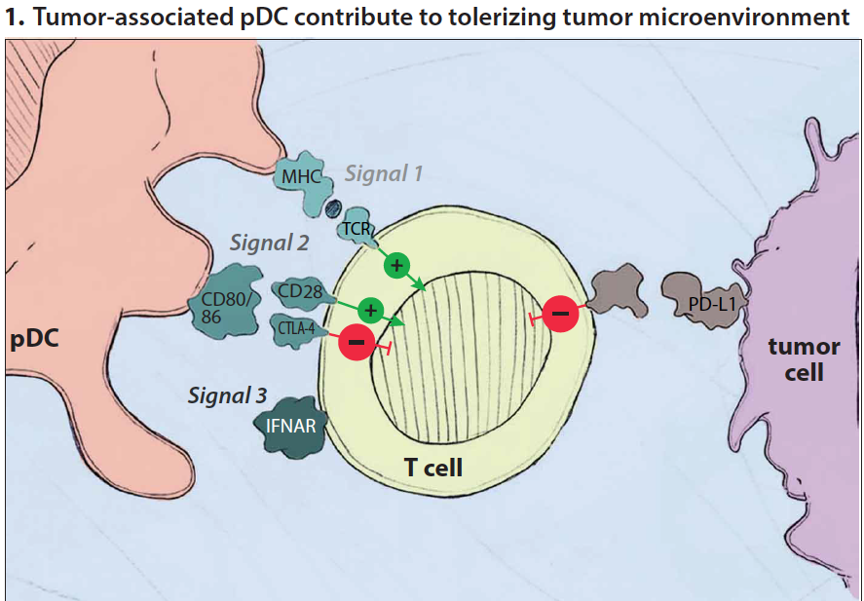
The 3 Signal Model of Tumor Immunity Tumor Microenvironment Blocks Signals 2, 3

Slide 35
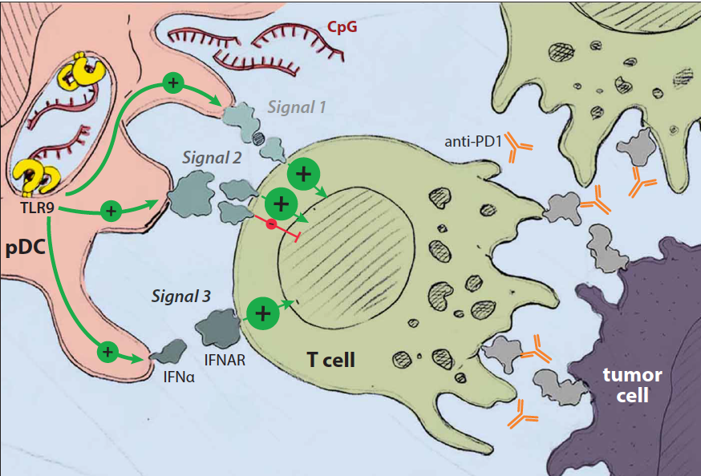
Checkmate CpG Activates All 3 Signals: Synergy with Anti-PD-1

Slide 36
Checkmate CpG Activates All 3 Signals: Synergy with Anti-PD-1
Of all immune activators CpG is the most Th1-like
Strongest CTL response in human cancer vaccine trials
Only systemic activator for plasmacytoid DC (pDC)

Slide 37
The Rationale For Activating pDC in Cancer with Intratumoral CpG
Many tumors (>50%) are infiltrated by immature pDC¹⁻⁴
Tumor-infiltrating pDC promote Treg, tolerize T cells^{1,2,5-9}
Tumors infiltrated by pDC have worse prognosis^{4,5,8}
CpG activate tumor-infiltrating pDC, induce Th1 cytokine milieu and stimulate CD8⁺ T cells^{2,5,7}
CpG strongest reported activator of tumor-infiltrating pDC
Zou et al., Nature Med 7:1339-46. 2001
Hartmann et al., Cancer Res 63:6478-87. 2003
Vermi et al., J Pathol 200:255-268. 2003
Treilleux et al., Clin Cancer Res 10:7466-74. 2004
Labidi-Galy et al., Cancer Res 71:5423-34. 2011
Watkins et al., J Clin Invest 121:1361-72. 2011
Sisirak et al., Cancer Res 72: 5188-97. 2012
Conrad et al., Cancer Res 72:5240-9. 2012
Faget et al., Cancer Res 72:6130-41. 2012

Slide 38
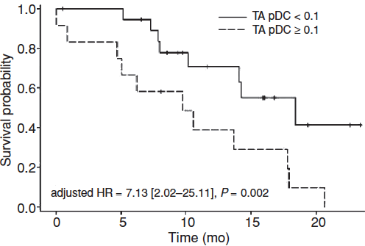
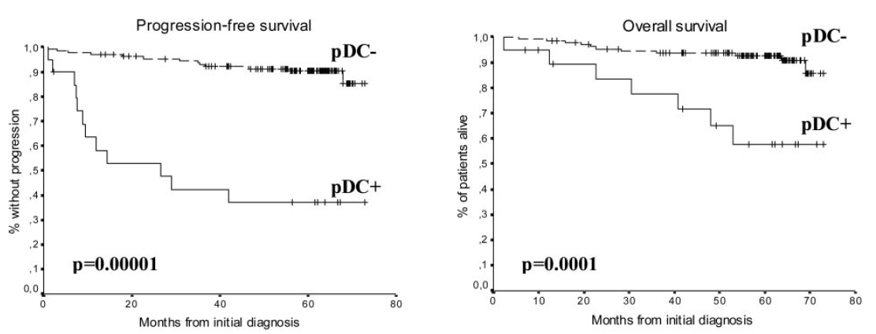
pDC Infiltration in Breast and Ovarian Cancer Confers Poor Prognosis
Breast Cancer Ovarian Cancer
pDC-
pDC+
pDC-
pDC+
In contrast, mDC infiltration of tumors confers good prognosis, longer survival
Treilleux et al. Clin Cancer Res. 2004
Labidy-Galy et al. Cancer Res. 2011

Slide 39
The Rationale For Activating pDC in Cancer with Intratumoral CpG
Many tumors (>50%) are infiltrated by immature pDC¹⁻⁴
Tumor-infiltrating pDC promote Treg, tolerize T cells^{1,2,5-9}
Tumors infiltrated by pDC have worse prognosis^{4,5,8}
CpG activate tumor-infiltrating pDC, induce Th1 cytokine milieu and stimulate CD8⁺ T cells^{2,5,7}
No other systemic therapeutic agent has been reported to activate tumor-infiltrating pDC
Zou et al., Nature Med 7:1339-46. 2001
Hartmann et al., Cancer Res 63:6478-87. 2003
Vermi et al., J Pathol 200:255-268. 2003
Treilleux et al., Clin Cancer Res 10:7466-74. 2004
Labidi-Galy et al., Cancer Res 71:5423-34. 2011
Watkins et al., J Clin Invest 121:1361-72. 2011
Sisirak et al., Cancer Res 72: 5188-97. 2012
Conrad et al., Cancer Res 72:5240-9. 2012
Faget et al., Cancer Res 72:6130-41. 2012

Slide 40
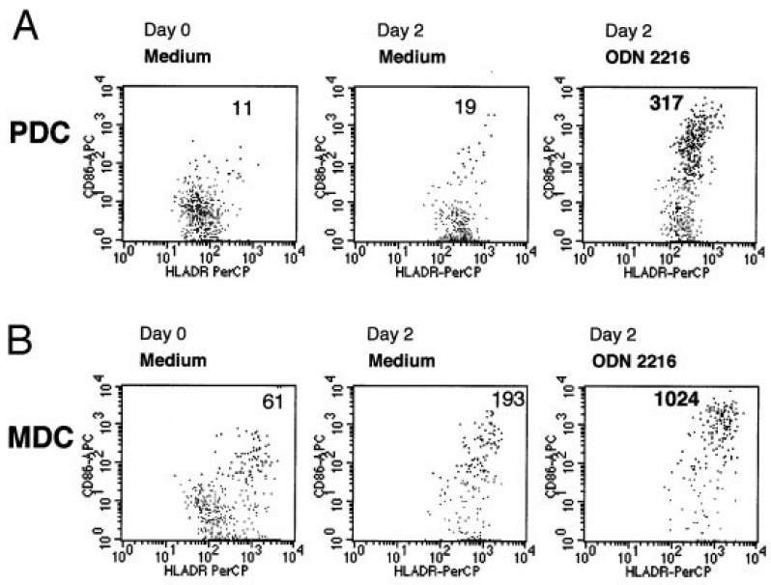
CpG Induces MHC Expression In Tumor-Associated pDC And mDC (Signal 1)
Control CpG-A
Conclusion:
CpG rapidly enhances antigen presentation by pDC and mDC (bystander effect on mDC)
Tumor-draining
Plasmacytoid DC
Tumor-draining
Myeloid DC
Single cell suspensions from head and neck cancer tumor-draining LN were cultured +/- CpG (2 μg/ml) for 48hr
Hartmann et al., Cancer Res. 2003

Slide 41
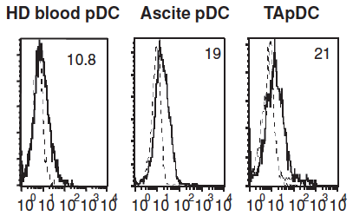
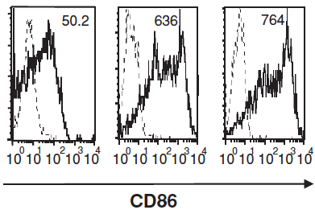
CpG Induces Costimulatory CD86 Expression On Tumor-Associated pDC (Signal 2)
Normal Ascites Tumor
pDC pDC pDC
Rapid pDC functional maturation shifts from tolerogenic to immunogenic state
Untreated
CpG
pDC were purified from normal PBMC, ovarian cancer ascites, or biopsies and cultured +/- CpG (5 μg/ml) for 24 hr before FACS
Labidy-Galy et al. Cancer Res. 2011

Slide 42
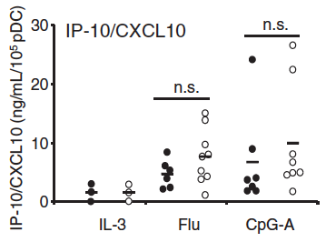
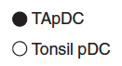
CpG Activates Tumor-Associated pDC To Secrete IFN-Inducible Th1 Chemokine (Signal 3)
Conclusion: CpG activates Th1-like IFN and chemokine response in normal and tumor pDC
Th1 chemokine (IP-10, ng/ml)
TA pDC
Control (tonsil) pDC
Control CpG-A
pDC were purified from triple negative breast tumor biopsies or tonsils and cultured +/- CpG (5 μg/ml) for 24 hr (for technical reasons, IFN-a is hard to measure in such cultures)
Sisirak et al., Cancer Res. 2012

Slide 44
Effects of Peritumoral CPG7909 in Resected Melanoma
Enlarged draining lymph nodes
Activated pDC and mDC (increased CD40, CD86)
Th1-skewing: Increased CD8⁺ T cell IFN-g secretion following in vitro restimulation
Reduced Treg
Increased tumor-specific CD8⁺ T cells in PBMC
50% of patients mount new CD8⁺ T cell responses to >1 TAA (in PBMC and sentinel lymph node)
Molenkamp et al., Clin Cancer Res, 2007 and 2008

Slide 45
Peritumoral CPG7909 induces anti-tumor CTL CD8⁺ T cell Response Correlates with pDC Activation
Molenkamp et al., Clin Cancer Res, 2008

Slide 46
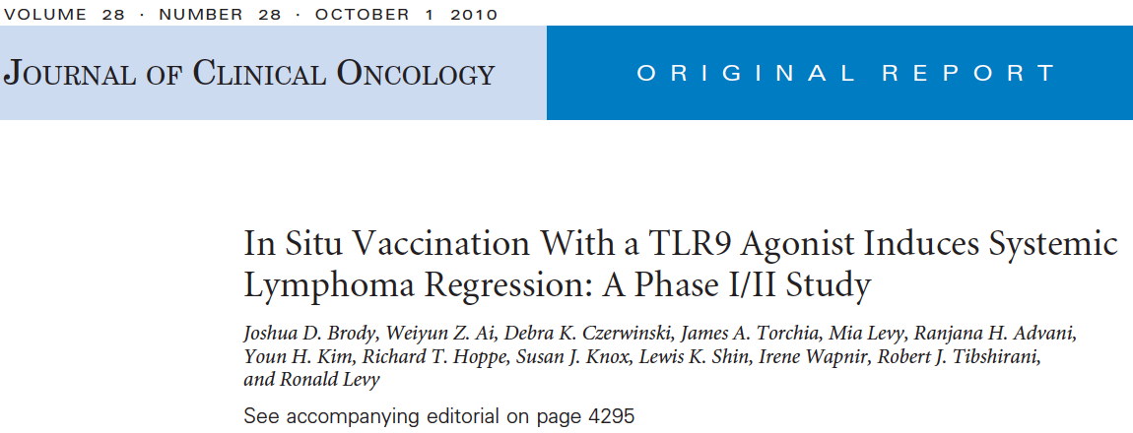
Efficacy of Intratumoral CPG7909 in NHL

Slide 47
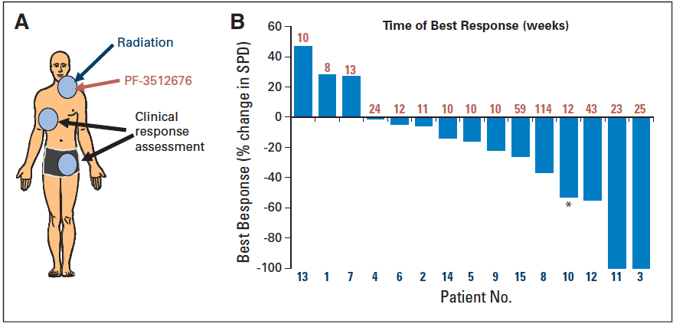
Efficacy of Intratumoral CPG7909 in NHL

Slide 48
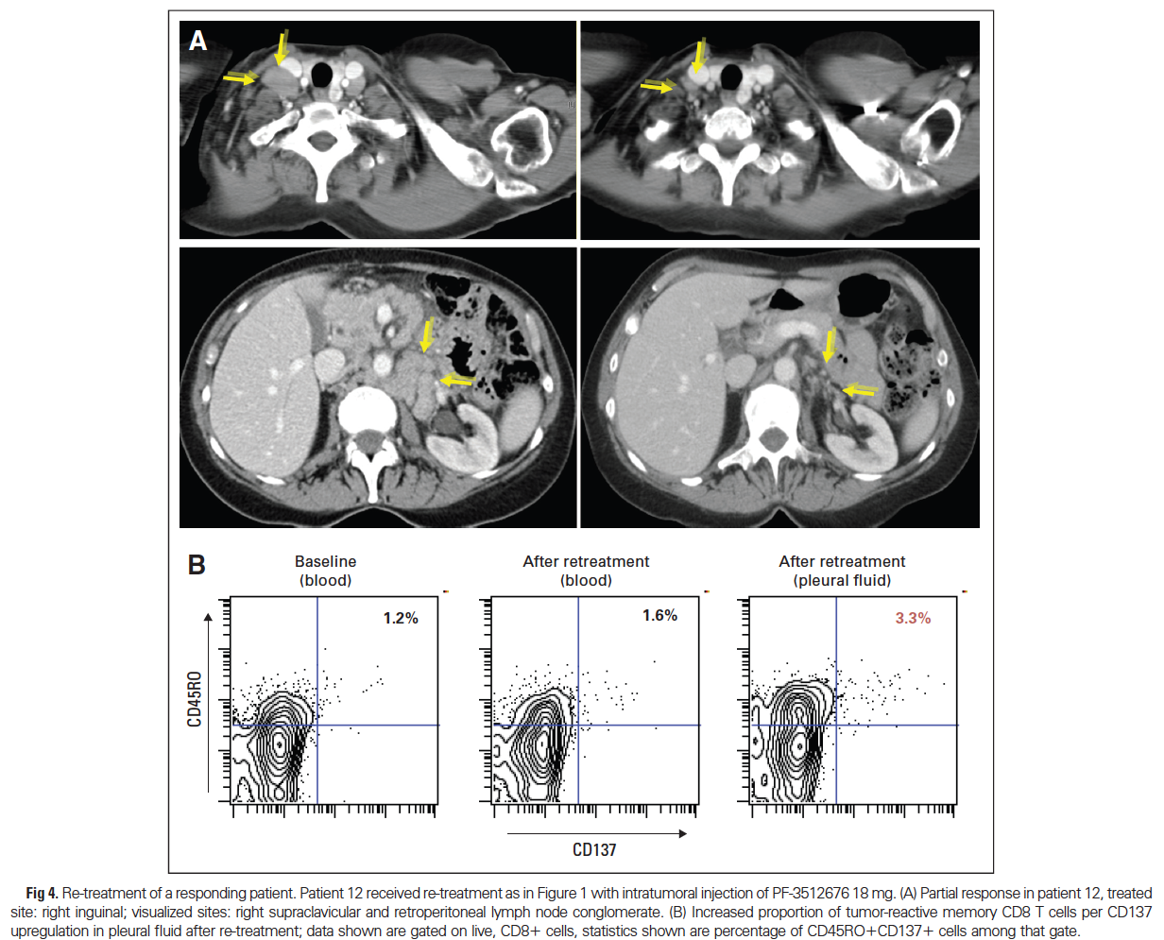
Efficacy of Intratumoral CPG7909 in NHL Retreatment of responding pt. boosts anti-tumor CD8⁺ T cells

Slide 49
Checkmate Clinical Strategy
Determine whether Checkmate CpG enhances anti-tumor activity of anti-PD-1 therapy
Evidence Part 1: Demonstrate enhanced efficacy with CpG addition Evidence Part 2: Demonstrate biomarker impact of intratumoral CpG in human cancer
We expect to start dosing by end of 2015

Slide 50
What Are We Doing Differently From Earlier CpG Development?
Intratumoral immunotherapy – focus innate immune activation on the tumor, altering the TME to induce tumor-specific adaptive immunity
Combine with checkpoint inhibitor instead of chemotherapy – Coley/Pfizer was ahead of its time
Checkmate CpG is the strongest type I IFN inducer known
Improving ORR to partially effective PD-1 therapy provides straightforward pathway to fast clinical POC

Slide 51
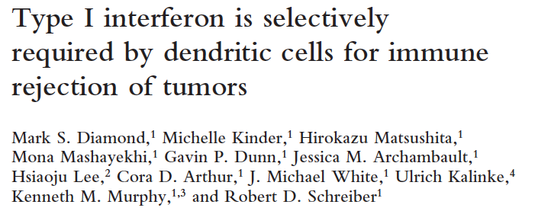
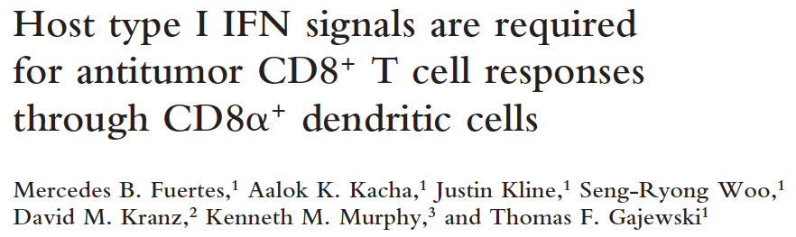
Key Role of IFN-a In Tumor Rejection
Type I IFN:
Augments CD8⁺ T cell survival, expansion, and effector differentiation
Promotes DC maturation, cross-presentation of TAA to CD8⁺ T cells
Required for immune surveillance against carcinogen-induced tumors
Required for rejection of implanted tumors
Levels of IFN-related mRNA correlate with TILs in human metastases
JEM, 2011

Slide 52
IFN-a Induction of New Checkmate CpG-A
CpG-A
CpG-B
CpG-C
New Checkmate CpG

Slide 53
Questions?

Slide 54
Back-up
CONFIDENTIAL

Slide 55







Immune Stimulatory IO Competitors
Company | Technology / Asset | Issues
 | Intratumoral STING ligands (preclin.); listeria vaccine ph2 | Activates most cells, IFN-b from cDC; no pDC activation
 | Intratumoral TLR4 agonist (phase 1); vaccines (ph 1) | High TNF-a, very low IFN-a, no pDC activation
 | Oligo RIG-I ligands (preclin) | Modest IFN-a, no pDC activation
 | TLR3 agonists (polyIC; phase 2 in GBM) | Moderate IFN-g, low IFN-a, activates mDC but not pDC
 | TLR8 sm molecule agonists (phase 2, ovarian and head and neck) | Activates monocytes, neutrophils but not pDC; some IFN-g but not IFN-a
 | Intratumoral IL-12 plasmid (ph2 melanoma, CTCL, MCC) | Plasmid may weakly activate TLR9, but low IFN-a
 | DNA vaccine and cytokines(ph2 cervical cancer) | DNA vaccines weak in primates, low IFN-a
Oncolytic Virus Companies | Amgen OncoVex; BeneVir; Cold Genesys; Omnis; DNAtrix; Genelux; AZ … | Complex CMC and nonspecific inflammatory effects
(Formerly
Anza)

Slide 56
Immune Stimulatory IO Competitors
Company | Technology / Asset | Issues
 | Intratumoral STING ligands (preclin.); listeria vaccine ph2 | Activates most cells, IFN-b from cDC; no pDC activation
 | Intratumoral TLR4 agonist (phase 1); vaccines (ph 1) | High TNF-a, very low IFN-a, no pDC activation
 | Oligo RIG-I ligands (preclin) | Modest IFN-a, no pDC activation
 | TLR3 agonists (polyIC; phase 2 in GBM) | Moderate IFN-g, low IFN-a, activates mDC but not pDC
 | TLR8 sm molecule agonists (phase 2, ovarian and head and neck) | Activates monocytes, neutrophils but not pDC; some IFN-g but not IFN-a
 | Intratumoral IL-12 plasmid (ph2 melanoma, CTCL, MCC) | Plasmid may weakly activate TLR9, but low IFN-a
 | DNA vaccine and cytokines(ph2 cervical cancer) | DNA vaccines weak in primates, low IFN-a
Oncolytic Virus Companies | Amgen OncoVex; BeneVir; Cold Genesys; Omnis; DNAtrix; Genelux; AZ … | Complex CMC and nonspecific inflammatory effects
(Formerly
Anza)
No competitor has a strong pDC activator or selective IFN-a inducer

Slide 57
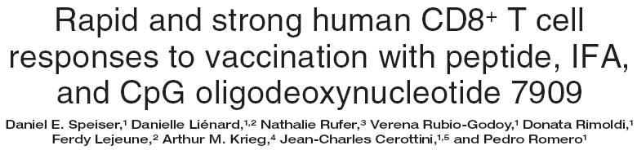
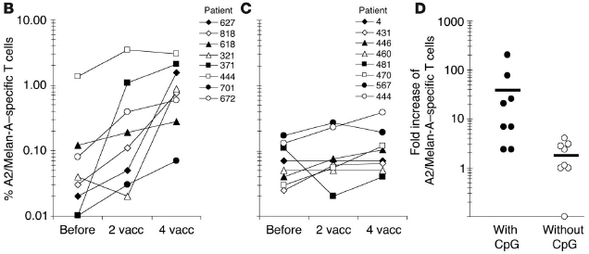
Melan-A + IFA
+ CPG 7909 (0.5mg)
Melan-A + IFA
4 doses, monthly intervals, N=8 per group
Speiser et al., 2005, J Clin Invest 115:739

Slide 58
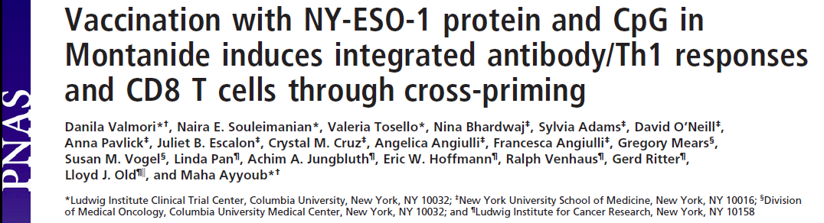
CpG As Tumor Vaccine Adjuvant Induces CD8⁺ T cell Response In Melanoma Patients
All but 1 pt developed CD4⁺ T cells
½ pts developed CD8⁺ T cells
Ab, CD4⁺ T cells develop early, CD8⁺ T cells later
No other adjuvant has induced CD8⁺ T cells to NY-ESO-1
Valmori et al., PNAS, 2007

Slide 59
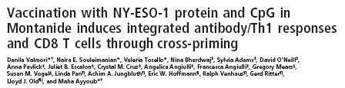
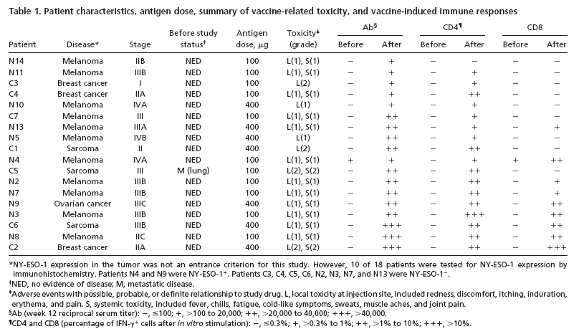
VaxImmune with tumor antigens
Valmori et al., PNAS, 2007, 104: 8947-52

Slide 60
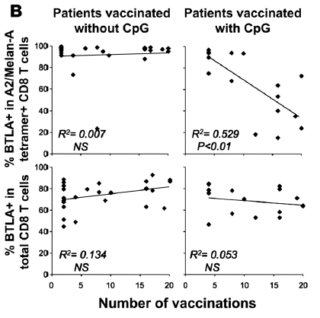
CpG Oligo Induces Qualitative Maturation of CD8⁺ T cell Response In Melanoma Patients
Tumor-specific CD8⁺ T cells express elevated BTLA that inhibits function
Vaccination without CpG doesn’t alter BTLA expression
Prolonged vaccination with CpG reduces the % BTLA⁺ tumor-specific CD8⁺ T cells
Derre et al., JCI, 2010

Slide 61
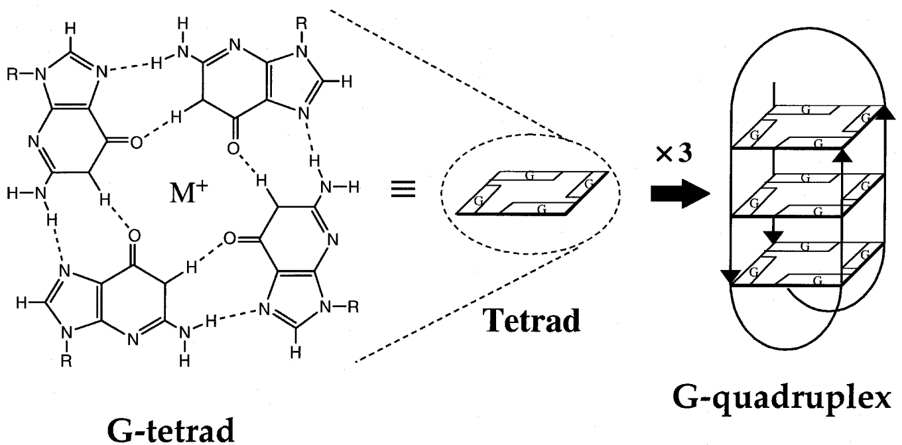
Three Distinct CpG Oligo Structures
CpG-A 2216
G*G*GGGACGATCGTCG*G*G*G*G*G
CpG are phosphodiester, palindrome
Poly G in CpG-A self-assemble into G-tetrads that stack to form
G-quadruplexes
CpG-B 2006 / PF-3512676
TCGTCGTTTTGTCGTTTTGTCGTT
CpG are phosphorothioate, linear
CpG-C 2395
TCGTCGTTTTCGGCGCGCGCCG
GCCGCGCGCGGCTTTTGCTGCT 5’
5’ CpG are phosphorothioate, 3’ palindrome forms dimers
CpG-A G-quadruplexes determine cell localization and signaling:
CpG-A to early endosomes; CpG-B to late endosomes
CpG-A primarily activate IRF7; CpG-B activate NF-kB

Slide 62
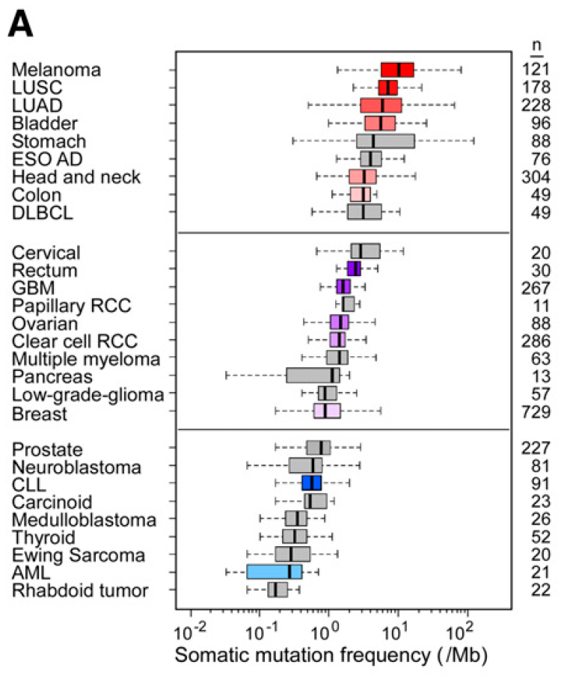
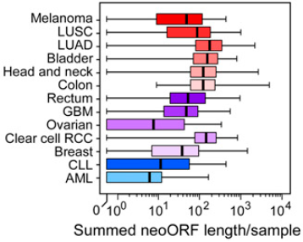
High Neoantigen Frequency In Most Cancers Suggests vast potential for effective immunotherapy
Immunotherapy efficacy is more likely limited by lack of Th1 activation than by lack of neoantigens
Rajasagi et al, BLOOD, 2014

